Slide 1
Image Classification

Slide 2

Image Classification
Image Classification is the task of assigning an input image one label from a fixed set of categories.
Example. For example, in the image below an image classification model takes a single image and assigns probabilities to 4 labels, {cat, dog, hat, mug}. As shown in the image, keep in mind that to a computer an image is represented as one large 3-dimensional array of numbers. In this example, the cat image is 248 pixels wide, 400 pixels tall, and has three color channels Red, Green, Blue (or RGB for short). Therefore, the image consists of 248 x 400 x 3 numbers, or a total of 297,600 numbers. Each number is an integer that ranges from 0 (black) to 255 (white). Our task is to turn this quarter of a million numbers into a single label, such as “cat”.

Slide 3
Challenges.
Keeping in mind the raw representation of images as a 3-D array of brightness values:
Viewpoint variation. A single instance of an object can be oriented in many ways with respect to the camera.
Scale variation. Visual classes often exhibit variation in their size (size in the real world, not only in terms of their extent in the image).
Deformation. Many objects of interest are not rigid bodies and can be deformed in extreme ways.
Occlusion. The objects of interest can be occluded. Sometimes only a small portion of an object (as little as few pixels) could be visible.
Illumination conditions. The effects of illumination are drastic on the pixel level.
Background clutter. The objects of interest may blend into their environment, making them hard to identify.
Intra-class variation. The classes of interest can often be relatively broad, such as chair. There are many different types of these objects, each with their own appearance.
A good image classification model must be invariant to the cross product of all these variations, while simultaneously retaining sensitivity to the inter-class variations.

Slide 4
Challenges…

Slide 5
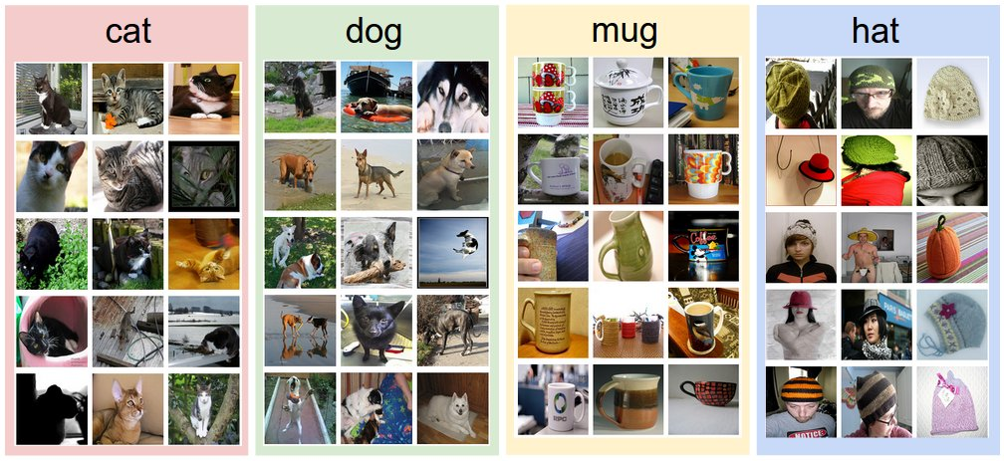
Data-driven approach
provide the computer with many examples of each class and then develop learning algorithms that look at these examples and learn about the visual appearance of each class.
This approach is referred to as a data-driven approach, since it relies on first accumulating a training dataset of labeled images. Here is an example of what such a dataset might look like:

Slide 6
The image classification pipeline
We’ve seen that the task in Image Classification is to take an array of pixels that represents a single image and assign a label to it. Our complete pipeline can be formalized as follows:
Input: Our input consists of a set of N images, each labeled with one of K different classes. We refer to this data as the training set.
Learning: Our task is to use the training set to learn what every one of the classes looks like. We refer to this step as training a classifier, or learning a model.
Evaluation: In the end, we evaluate the quality of the classifier by asking it to predict labels for a new set of images that it has never seen before. We will then compare the true labels of these images to the ones predicted by the classifier. Intuitively, we’re hoping that a lot of the predictions match up with the true answers (which we call the ground truth).

Slide 7
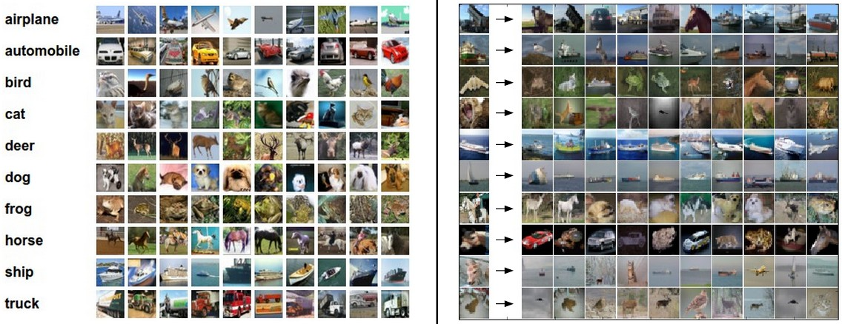
Nearest Neighbor Classifier
Example image classification dataset: CIFAR-10. One popular toy image classification dataset is the CIFAR-10 dataset. This dataset consists of 60,000 tiny images that are 32 pixels high and wide. Each image is labeled with one of 10 classes (for example “airplane, automobile, bird, etc”). These 60,000 images are partitioned into a training set of 50,000 images and a test set of 10,000 images. In the image below you can see 10 random example images from each one of the 10 classes:
Left: Example images from the CIFAR-10 dataset. Right: first column shows a few test images and next to each we show the top 10 nearest neighbors in the training set according to pixel-wise difference.

Slide 8
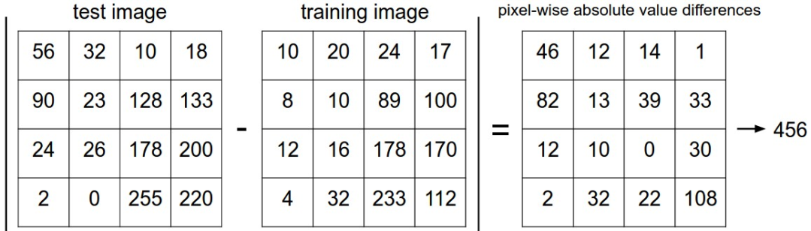
Nearest Neighbor Approach
Suppose now that we are given the CIFAR-10 training set of 50,000 images (5,000 images for every one of the labels), and we wish to label the remaining 10,000. The nearest neighbor classifier will take a test image, compare it to every single one of the training images, and predict the label of the closest training image. In the image above and on the right you can see an example result of such a procedure for 10 example test images. Notice that in only about 3 out of 10 examples an image of the same class is retrieved, while in the other 7 examples this is not the case. For example, in the 8th row the nearest training image to the horse head is a red car, presumably due to the strong black background. As a result, this image of a horse would in this case be mislabeled as a car.
How we compare two images? (in this case are just two blocks of 32 x 32 x 3.)
One of the simplest possibilities is to compare the images pixel by pixel and add up all the differences. In other words, given two images and representing them as vectors I1,I2 , a reasonable choice for comparing them might be the L1 distance:
Where the sum is taken over all pixels.

Slide 9
Nearest Neighbor Approach
Nearest Neighbor Classifier achieves 38.6% on CIFAR-10.
That’s more impressive than guessing at random (which would give 10% accuracy since there are 10 classes), but nowhere near human performance (which is estimated at about 94%) or near state-of-the-art Convolutional Neural Networks that achieve about 95%, matching human accuracy.
The choice of distance. There are many other ways of computing distances between vectors. Another common choice could be to instead use the L2 distance, which has the geometric interpretation of computing the euclidean distance between two vectors. The distance takes the form:
If you ran the Nearest Neighbor classifier on CIFAR-10 with this distance, you would obtain 35.4% accuracy (slightly lower than our L1 distance result).

Slide 10
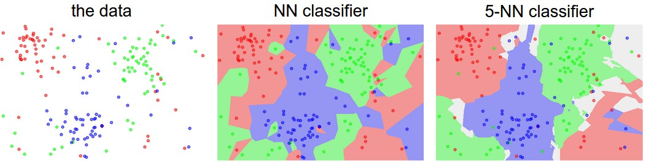
k - Nearest Neighbor Classifier
You may have noticed that it is strange to only use the label of the nearest image when we wish to make a prediction. Indeed, it is almost always the case that one can do better by using what’s called a k-Nearest Neighbor Classifier. The idea is very simple: instead of finding the single closest image in the training set, we will find the top k closest images, and have them vote on the label of the test image. In particular, when k = 1, we recover the Nearest Neighbor classifier. Intuitively, higher values of k have a smoothing effect that makes the classifier more resistant to outliers:
The white regions show points that are ambiguously classified (i.e. class votes are tied for at least two classes). Notice that in the case of a NN classifier, outlier datapoints (e.g. green point in the middle of a cloud of blue points) create small islands of likely incorrect predictions, while the 5-NN classifier smooths over these irregularities, likely leading to better generalization on the test data (not shown). Also note that the gray regions in the 5-NN image are caused by ties in the votes among the nearest neighbors (e.g. 2 neighbors are red, next two neighbors are blue, last neighbor is green).

Slide 11
Linear Classification
In the above equation, we are assuming that the image(X) has all of its pixels flattened out to a single column vector of shape [D x 1].
The matrix W (of size [K x D]), and
the vector b (of size [K x 1]) are the parameters of the function.
In CIFAR-10,
Each Image contains all pixels flattened into a single [3072 x 1] column,
W is [10 x 3072] and
b is [10 x 1], so 3072 numbers come into the function (the raw pixel values) and 10 numbers come out (the class scores).
The parameters in W are often called the weights, and b is called the bias vector because it influences the output scores, but without interacting with the actual data of each image.

Slide 12
Linear Classification
There are a few things to note:
Single matrix multiplication W *Xi is effectively evaluating 10 separate classifiers in parallel (one for each class), where each classifier is a row of W.
Notice also that we think of the input data (X,Y) as given and fixed, but we have control over the setting of the parameters W, b. Our goal will be to set these in such way that the computed scores match the ground truth labels across the whole training set.
An advantage of this approach is that the training data is used to learn the parameters W,b, but once the learning is complete we can discard the entire training set and only keep the learned parameters. That is because a new test image can be simply forwarded through the function and classified based on the computed scores.
Lastly, note that to classifying the test image involves a single matrix multiplication and addition, which is significantly faster than comparing a test image to all training images.

Slide 13
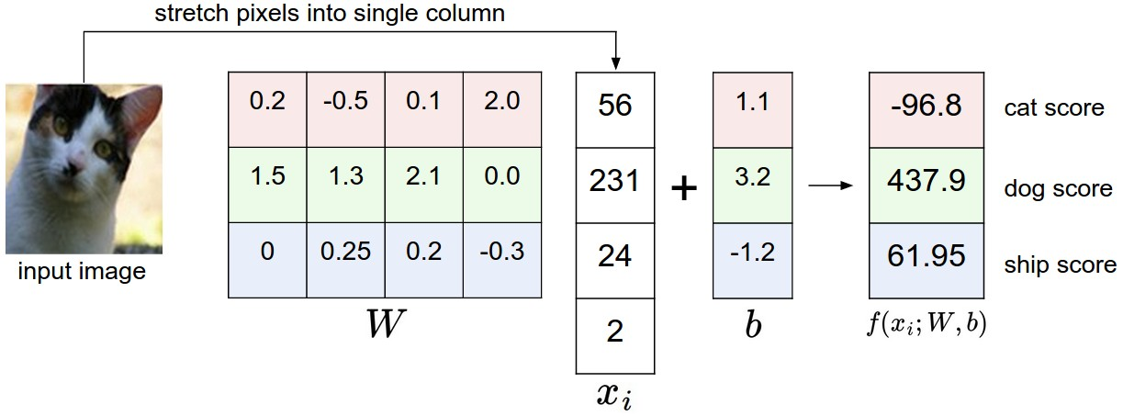
Linear Classification
An example of mapping an image to class scores. For the sake of visualization, we assume the image only has 4 pixels and that we have 3 classes (red (cat), green (dog), blue (ship) class). We stretch the image pixels into a column and perform matrix multiplication to get the scores for each class.
Note that this particular set of weights W is not good at all: the weights assign our cat image a very low cat score. In particular, this set of weights seems convinced that it's looking at a dog.

Slide 14
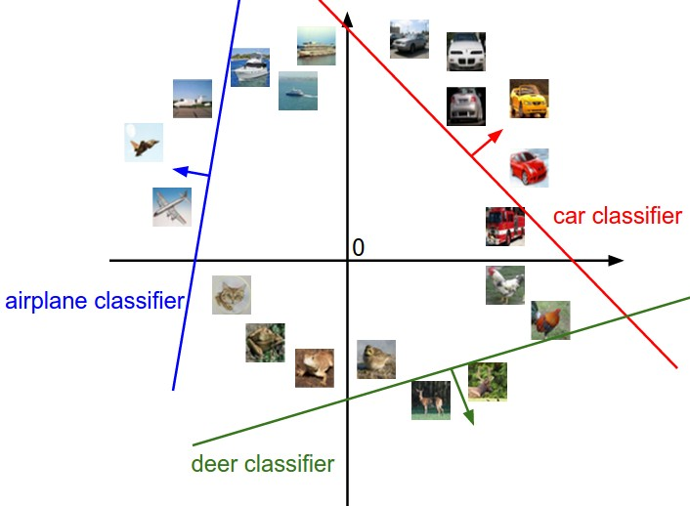
Linear Classification
Analogy of images as high-dimensional points. Since the images are stretched into high-dimensional column vectors, we can interpret each image as a single point in this space (e.g. each image in CIFAR-10 is a point in 3072-dimensional space of 32x32x3 pixels). Analogously, the entire dataset is a (labeled) set of points.

Slide 15
Interpretation of linear classifiers
Interpretation of linear classifiers as template matching.
Another interpretation for the weights W is that each row of W correspon ds to a template (or sometimes also called a prototype) for one of the classes. The score of each class for an image is then obtained by comparing each template with the image using an inner product (or dot product) one by one to find the one that “fits” best. With this terminology, the linear classifier is doing template matching, where the templates are learned.
Interpretation of linear classifiers as Nearest Neighbor finding
Another way to think of it is that we are still effectively doing Nearest Neighbor, but instead of having thousands of training images we are only using a single image per class (although we will learn it, and it does not necessarily have to be one of the images in the training set), and we use the (negative) inner product as the distance instead of the L1 or L2 distance.

Slide 16
Linear classifiers-observations
Additionally, note that the horse template seems to contain a two-headed horse, which is due to both left and right facing horses in the dataset. The linear classifier merges these two modes of horses in the data into a single template.
Similarly, the car classifier seems to have merged several modes into a single template which has to identify cars from all sides, and of all colors. In particular, this template ended up being red, which hints that there are more red cars in the CIFAR-10 dataset than of any other color.
The linear classifier is too weak to properly account for different-colored cars..

Slide 17
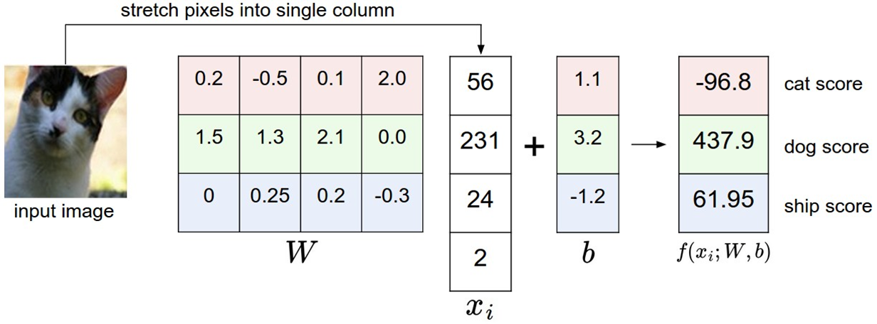
Loss function
We want to set W and b so that the predicted class scores are consistent with the ground truth labels in the training data.
We are going to measure our unhappiness with outcomes such as this one with a loss function (or sometimes also referred to as the cost function or the objective). Intuitively, the loss will be high if we’re doing a poor job of classifying the training data, and it will be low if we’re doing well.
The loss function quantifies our unhappiness with predictions on the training set

Slide 18
Linear Support Vector Machine (SVM)
Linear Support Vector Machine (SVM) which constructs a maximum-margin separating hyperplane between data classes in an n-dimensional space. The goal of this separating hyperplane is to place all examples (or as many as possible, given some tolerance) of class i on one side of the hyperplane and then all examples not of class i on the other side of the hyperplane.

Slide 19
Multiclass Support Vector Machine Loss Function
The Multiclass Support Vector Machine "wants" the score of the correct class to be higher than all other scores by at least a margin of delta. If any class has a score inside the red region (or higher), then there will be accumulated loss. Otherwise the loss will be zero. Our objective will be to find the weights that will simultaneously satisfy this constraint for all examples in the training data and give a total loss that is as low as possible.
Which implies that we can obtain the predicted score of the j-th class via for the i-th data point:
Using this syntax, we can put it all together, obtaining the hinge loss function:

Slide 20
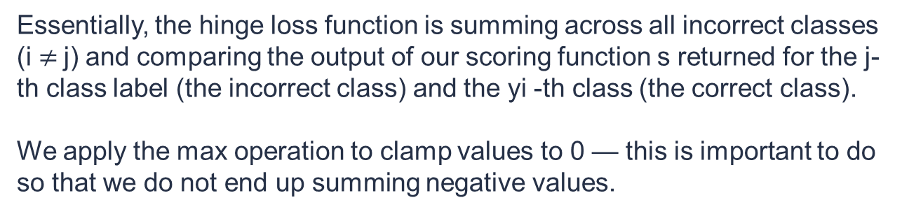
Multiclass Support Vector Machine Loss Function
Essentially, the hinge loss function is summing across all incorrect classes (i $≠$j) and comparing the output of our scoring function s returned for the j-th class label (the incorrect class) and the yi -th class (the correct class).
We apply the max operation to clamp values to 0 — this is important to do so that we do not end up summing negative values.
A given xi is classified correctly when the loss Li = 0 (I’ll provide a numerical example of this in the following section).
To derive the loss across our entire training set, we simply take the mean over each individual Li:

Slide 21
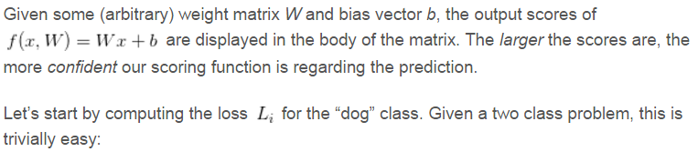
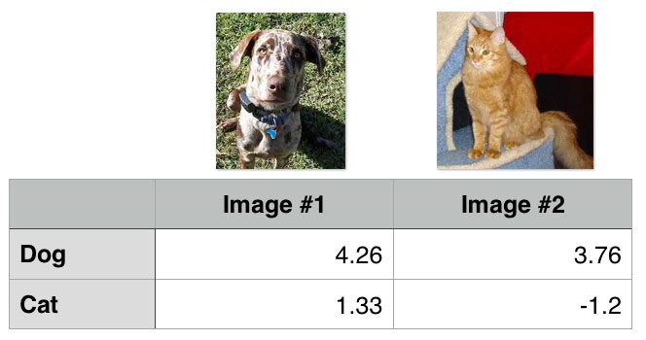
Multiclass Support Vector Machine Loss Function
>>> max(0, 1.33 - 4.26 + 1) = 0
Notice how the loss for “dog” is zero — this implies that the dog class was correctly predicted. A quick investigation of Figure 1 above demonstrates this to be true: the “dog” score is greater than the “cat” score.
Similarly, we can do the same for the second image, this one containing a cat:
>>> (0 + 5.96) / 2 = 2.98
In this case, our loss function is greater than zero, indicating that our prediction is not correct.
We then obtain the total loss over the two example images by taking the average:

Slide 22
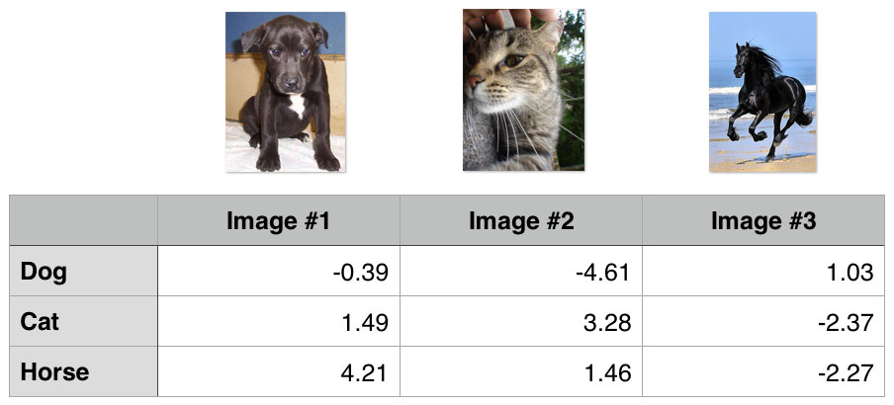
Multiclass Support Vector Machine Loss Function
Let’s again compute the loss for the dog class:
> max(0, 1.49 - (-0.39) + 1) + max(0, 4.21 - (-0.39) + 1) =8.48
Notice how that our summation has expanded to include two terms — the difference between the predicted dog score and both the cat and horse score.
Similarly, we can compute the loss for the cat class:
> max(0, -4.61 - 3.28 + 1) + max(0, 1.46 - 3.28 + 1) =0
And finally the loss for the horse class:
> max(0, 1.03 - (-2.27) + 1) + max(0, -2.37 - (-2.27) + 1) = 5.19

Slide 23
Optimization of Weights (convex problem)
The goal of optimization is to find W that minimizes the loss function.
Strategy #1: Random search (A first very bad idea solution)
Simply check how good a given set of parameters W is, the first (very bad) idea that may come to mind is to simply try out many different random weights and keep track of what works best. After trying out several random weight vectors W, some of them would work better than others. We can take the best weights W found by this search and try it out on the test set.
With the best W this would give an accuracy of about 15.5% after 1000 iterations. Given that guessing classes completely at random achieves only 10%,( 10 classes) that’s not a very bad outcome for a such a brain-dead random search solution!
.

Slide 24
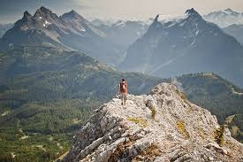

Optimization
Strategy #2: Random Local Search
Start with random weights and iteratively refine them over time to get lower loss.
Start out with a random W, generate random perturbations δW to it and if the loss at the perturbed W+δW is lower, we will perform an update the weight.
After 1000 iterations, this approach achieves test set classification accuracy of 21.4%. This is better, but still wasteful and computationally expensive
Think of yourself as hiking on a hilly terrain with a blindfold on, and trying to reach the bottom. In the example of CIFAR-10, the hills are 30,730-dimensional, since the dimensions of W are 3073 x 10. At every point on the hill we achieve a particular loss (the height of the terrain).
The first strategy you may think of is to try to extend one foot in a random direction and then take a step only if it leads downhill.

Slide 25

Optimization
Strategy #3: Following the Gradient
In random Local Search strategy randomly search for good direction to minimize the loss. We can compute the best direction along which we should change our weight vector that is mathematically guaranteed to be the direction of the steepest descend.
This direction will be related to the gradient of the loss function.
In our hiking analogy, this approach roughly corresponds to feeling the slope of the hill below our feet and stepping down the direction that feels steepest.
In one-dimensional functions, the slope is the instantaneous rate of change of the function at any point you might be interested in. The rate of change of the function is called as derivative of a function.
In practice it often works better to compute the numeric gradient using the centered difference formula:
The procedure of repeatedly evaluating the gradient and then performing a parameter update is called Gradient Descent.

Slide 26
Backpropagation,
Simple expressions and interpretation of the gradient
Consider a simple multiplication function of two numbers
It is a matter of simple calculus to derive the partial derivative for either input:
Interpretation. Actually Derivatives indicate the rate of change of a function with respect to that variable surrounding an infinitesimally small region near a particular point:
=
When h is very small, then the function is well-approximated by a straight line, and the derivative is its slope. In other words, the derivative on each variable tells you the sensitivity of the whole expression on its value.
Fore example if x= 4 and y =3 then f(x,y) =-12, and the derivative wrt x (df/dfx) =-3. This tells us that if we were to increase the value of this variable by a tiny amount the effect of the whole expression would be to decrease it and by amount three times the amount. This can be see by rearranging the above equation as
The derivative on each variable tells you the sensitivity of the whole expression on its value.

Slide 27
Compound expressions with chain rule
Consider the expression f(x,y,z) = (x+y) z
Let q=(x+y) then f= qz
df/dq = z and
df/fz = q = but q= (x+Y) => dq/dx=1, dq/dy =1
Chain Rule =
At the end we are left with the gradient in the variables [df/dx,df/dy,df/dz], which tell us the sensitivity of the variables x,y,z on f. This is the simplest example of backpropagation.

Slide 28
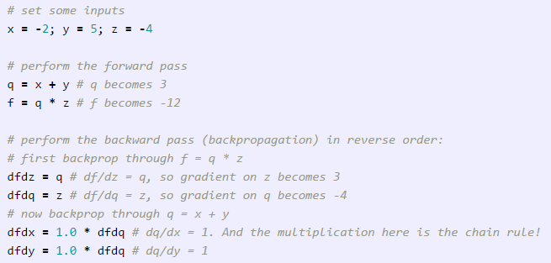
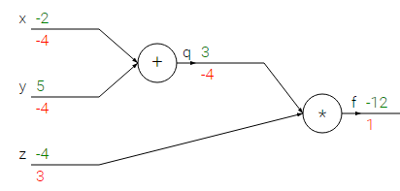
Backpropagation
The forward pass computes values from inputs to output (shown in green). The backward pass then performs backpropagation which starts at the end and recursively applies the chain rule to compute the gradients (shown in red) all the way to the inputs of the circuit. The gradients can be thought of as flowing backwards through the circuit.

Slide 29
Intuitive understanding of backpropagation
Backpropagation is a beautifully local process.
Every gate in a circuit diagram gets some inputs and can right away compute two things:
its output value and
the local gradient of its inputs with respect to its output value.
Notice that the gates can do this completely independently without being aware of any of the details of the full circuit that they are embedded in.
However, once the forward pass is over, during backpropagation the gate will eventually learn about the gradient of its output value on the final output of the entire circuit.
Chain rule says that the gate should take that gradient and multiply it into every gradient it normally computes for all of its inputs.
This extra multiplication (for each input) due to the chain rule can turn a single and relatively useless gate into a cog in a complex circuit such as an entire neural network.

Slide 30
Intuitive understanding of backpropagation
The add gate received inputs [-2, 5] and computed output 3.
Since the gate is computing the addition operation, its local gradient for both of its inputs is +1. The rest of the circuit computed the final value, which is -12.
During the backward pass in which the chain rule is applied recursively backwards through the circuit, the add gate (which is an input to the multiply gate) learns that the gradient for its output was -4.
If we anthropomorphize the circuit as wanting to output a higher value (which can help with intuition), then we can think of the circuit as “wanting” the output of the add gate to be lower (due to negative sign), and with a force of 4. To continue the recurrence and to chain the gradient, the add gate takes that gradient and multiplies it to all of the local gradients for its inputs (making the gradient on both x and y 1 * -4 = -4). Notice that this has the desired effect: If x,y were to decrease (responding to their negative gradient) then the add gate’s output would decrease, which in turn makes the multiply gate’s output increase.
Backpropagation can thus be thought of as gates communicating to each other (through the gradient signal) whether they want their outputs to increase or decrease (and how strongly), so as to make the final output value higher.

Slide 31
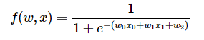
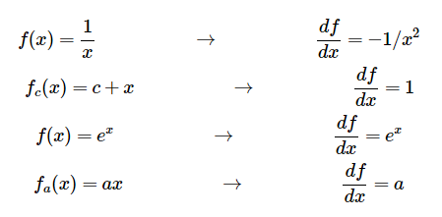
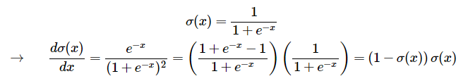
Modularity: Sigmoid example
Any kind of differentiable function can act as a gate, and we can group multiple gates into a single gate, or decompose a function into multiple gates whenever it is convenient. Lets look at another expression that illustrates this point:
The function is made up of multiple gates.
It turns out that the derivative of the sigmoid function with respect to its input simplifies if you perform the derivation.

Slide 32
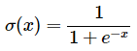
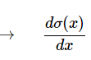
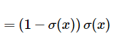
Modularity: Sigmoid example
As we see, the gradient turns out to simplify and becomes surprisingly simple.
For example, the sigmoid expression receives the input 1.0 and computes the output (1/1+exp(-1))= 0.73 during the forward pass.
The derivation above shows that the local gradient would simply be (1 - 0.73) * 0.73 ~= 0.2, except this way it would be done with a single, simple and efficient expression (and with less numerical issues).
Therefore, in any real practical application it would be very useful to group these operations into a single gate.

Slide 33
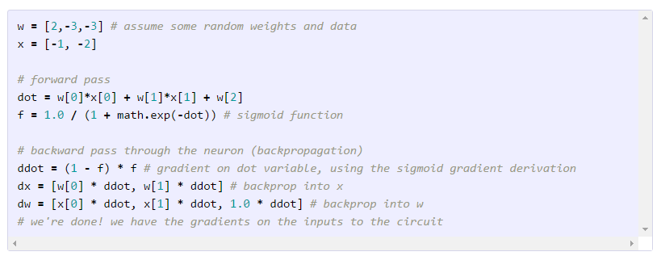
Backpropagation Code
As shown in the code above, in practice it is always helpful to break down the forward pass into stages that are easily back-propped through. For example here we created an intermediate variable dot which holds the output of the dot product between w and x. During backward pass we then successively compute (in reverse order) the corresponding variables (e.g. ddot, and ultimately dw, dx) that hold the gradients of those variables.

Slide 34
Back-propagation coding…
Cache forward pass variables.
To compute the backward pass it is very helpful to have some of the variables that were used in the forward pass. In practice you want to structure your code so that you cache these variables, and so that they are available during backpropagation. If this is too difficult, it is possible (but wasteful) to recompute them.
Gradients add up at forks.
The forward expression involves the variables x, y multiple times, so when we perform backpropagation we must be careful to use += instead of = to accumulate the gradient on these variables (otherwise we would overwrite it). This follows the multivariable chain rule in Calculus, which states that if a variable branches out to different parts of the circuit, then the gradients that flow back to it will add.

Slide 35
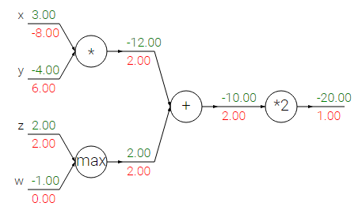
Backpropagation Code
Patterns in backward flow
It is interesting to note that in many cases the backward-flowing gradient can be interpreted on an intuitive level. For example, the three most commonly used gates in neural networks (add, mul, max), all have very simple interpretations in terms of how they act during backpropagation. Consider this example circuit:
Sum operation distributes gradients equally to all its inputs.
Max operation routes the gradient to the higher input.
Multiply gate takes the input activations, swaps them and multiplies by its gradient.

Slide 36
Backpropagation Code
The add gate always takes the gradient on its output and distributes it equally to all of its inputs, regardless of what their values were during the forward pass. This follows from the fact that the local gradient for the add operation is simply +1.0, so the gradients on all inputs will exactly equal the gradients on the output because it will be multiplied by x1.0 (and remain unchanged). In the example circuit above, note that the + gate routed the gradient of 2.00 to both of its inputs, equally and unchanged.
The max gate routes the gradient. Unlike the add gate which distributed the gradient unchanged to all its inputs, the max gate distributes the gradient (unchanged) to exactly one of its inputs (the input that had the highest value during the forward pass). This is because the local gradient for a max gate is 1.0 for the highest value, and 0.0 for all other values. In the example circuit above, the max operation routed the gradient of 2.00 to the z variable, which had a higher value than w, and the gradient on w remains zero.
The multiply gate is a little less easy to interpret. Its local gradients are the input values (except switched), and this is multiplied by the gradient on its output during the chain rule. In the example above, the gradient on x is -8.00, which is -4.00 x 2.00.

Slide 37
Unintuitive effects
Unintuitive effects and their consequences. Notice that if one of the inputs to the multiply gate is very small and the other is very big, then the multiply gate will do something slightly unintuitive: it will assign a relatively huge gradient to the small input and a tiny gradient to the large input. Note that in linear classifiers where the weights are dot producted (multiplied) with the inputs, this implies that the scale of the data has an effect on the magnitude of the gradient for the weights. For example, if you multiplied all input data examples x_{i} by 1000 during preprocessing, then the gradient on the weights will be 1000 times larger, and you’d have to lower the learning rate by that factor to compensate. This is why preprocessing matters a lot, sometimes in subtle ways!

Slide 38
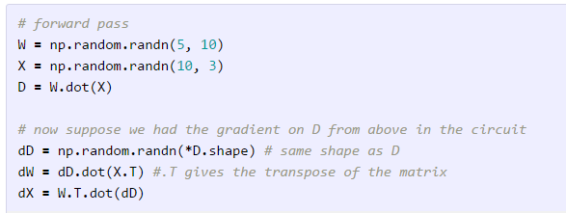
Gradients for vectorised operations
The above sections were concerned with single variables, but all concepts extend in a straight-forward manner to matrix and vector operations. However, one must pay closer attention to dimensions and transpose operations.
Matrix-Matrix multiply gradient. Possibly the most tricky operation is the matrix-matrix multiplication (which generalizes all matrix-vector and vector-vector) multiply operations:

Slide 39


Neural Network architectures
Left: A 2-layer Neural Network (one hidden layer of 4 neurons (or units) and one output layer with 2 neurons), and three inputs.
Right: A 3-layer neural network with three inputs, two hidden layers of 4 neurons each and one output layer. Notice that in both cases there are connections (synapses) between neurons across layers, but not within a layer.

Slide 40
Naming conventions
Notice that when we say N-layer neural network, we do not count the input layer. Therefore, a single-layer neural network describes a network with no hidden layers (input directly mapped to output). In that sense, you can sometimes hear people say that logistic regression or SVMs are simply a special case of single-layer Neural Networks. You may also hear these networks interchangeably referred to as “Artificial Neural Networks” (ANN) or “Multi-Layer Perceptrons” (MLP). Many people do not like the analogies between Neural Networks and real brains and prefer to refer to neurons as units.
Output layer. Unlike all layers in a Neural Network, the output layer neurons most commonly do not have an activation function (or you can think of them as having a linear identity activation function). This is because the last output layer is usually taken to represent the class scores (e.g. in classification), which are arbitrary real-valued numbers, or some kind of real-valued target (e.g. in regression).

Slide 41
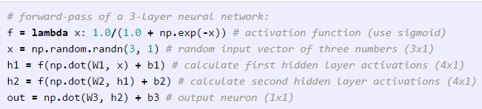
Example feed-forward computation
It turns out that Neural Networks with at least one hidden layer are universal approximators. In other words, the neural network can approximate any continuous function.
Neural Networks work well in practice because they compactly express nice, smooth functions that fit well with the statistical properties of data we encounter in practice, and are also easy to learn using our optimization algorithms (e.g. gradient descent).
As an aside, in practice it is often the case that 3-layer neural networks will outperform 2-layer nets, but going even deeper (4,5,6-layer) rarely helps much more.

Slide 42

Setting number of layers and their sizes
In the diagram above, we can see that Neural Networks with more neurons can express more complicated functions. However, this is both a blessing (since we can learn to classify more complicated data) and a curse (since it is easier to overfit the training data).
Overfitting occurs when a model with high capacity fits the noise in the data instead of the (assumed) underlying relationship. For example, the model with 20 hidden neurons fits all the training data but at the cost of segmenting the space into many disjoint red and green decision regions. The model with 3 hidden neurons only has the representational power to classify the data in broad strokes. In practice, this could lead to better generalization on the test set.

Slide 43
Data Preprocessing
Mean subtraction is the most common form of preprocessing. It involves subtracting the mean across every individual feature in the data, and has the geometric interpretation of centering the cloud of data around the origin along every dimension.
In numpy, this operation would be implemented as: X -= np.mean(X, axis = 0). With images specifically, for convenience it can be common to subtract a single value from all pixels (e.g. X -= np.mean(X)), or to do so separately across the three color channels.
Normalization refers to normalizing the data dimensions so that they are of approximately the same scale.
One is to divide each dimension by its standard deviation, once it has been zero-centered: (X /= np.std(X, axis = 0)).
Another form of this preprocessing normalizes each dimension so that the min and max along the dimension is -1 and 1 respectively.
In case of images, the relative scales of pixels are already approximately equal (and in range from 0 to 255), so it is not strictly necessary to perform this additional preprocessing step.

Slide 44
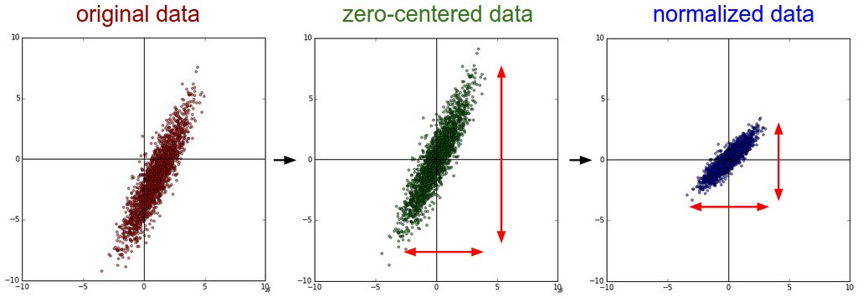
Data Preprocessing
Common data preprocessing pipeline. Left: Original toy, 2-dimensional input data. Middle: The data is zero-centered by subtracting the mean in each dimension. The data cloud is now centered around the origin. Right: Each dimension is additionally scaled by its standard deviation. The red lines indicate the extent of the data - they are of unequal length in the middle, but of equal length on the right.

Slide 45
PCA and Whitening
In this process, the data is first centered. Then, we can compute the covariance matrix that tells us about the correlation structure in the data:
# Assume input data matrix X of size [N x D]
X -= np.mean(X, axis = 0) # zero-center the data (important)
cov = np.dot(X.T, X) / X.shape[0] # get the data covariance matrix
Furthermore, the covariance matrix is symmetric and positive semi-definite. We can compute the SVD factorization of the data covariance matrix:
U,S,V = np.linalg.svd(cov)
where the columns of U are the eigenvectors and S is a 1-D array of the singular values. To decorrelate the data, we project the original (but zero-centered) data into the eigenbasis:
Xrot = np.dot(X, U) # decorrelate the data
A nice property of np.linalg.svd is that in its returned value U, the eigenvector columns are sorted by their eigenvalues. We can use this to reduce the dimensionality of the data by only using the top few eigenvectors, and discarding the dimensions along which the data has no variance. This is also sometimes refereed to as Principal Component Analysis (PCA) dimensionality reduction:
Xrot_reduced = np.dot(X, U[:,:100]) # Xrot_reduced becomes [N x 100]

Slide 46
PCA and Whitening
After this operation, we would have reduced the original dataset of size [N x D] to one of size [N x 100], keeping the 100 dimensions of the data that contain the most variance.
It is very often the case that you can get very good performance by training linear classifiers or neural networks on the PCA-reduced datasets, obtaining savings in both space and time.
The last transformation you may see in practice is whitening. The whitening operation takes the data in the eigenbasis and divides every dimension by the eigenvalue to normalize the scale. The geometric interpretation of this transformation is that if the input data is a multivariable gaussian, then the whitened data will be a gaussian with zero mean and identity covariance matrix. This step would take the form:
# whiten the data:
# divide by the eigenvalues (which are square roots of the singular values)
Xwhite = Xrot / np.sqrt(S + 1e-5)

Slide 47
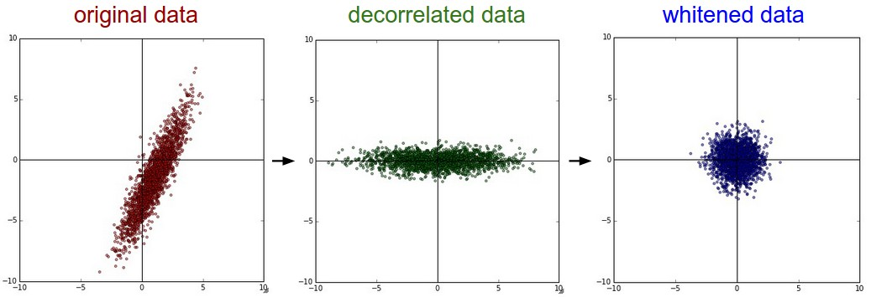
PCA and Whitening
PCA / Whitening. Left: Original toy, 2-dimensional input data. Middle: After performing PCA. The data is centered at zero and then rotated into the eigenbasis of the data covariance matrix. This decorrelates the data (the covariance matrix becomes diagonal). Right: Each dimension is additionally scaled by the eigenvalues, transforming the data covariance matrix into the identity matrix. Geometrically, this corresponds to stretching and squeezing the data into an isotropic gaussian blob.

Slide 48
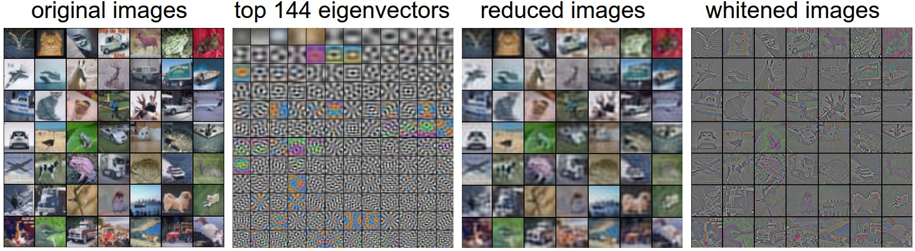
PCA and Whitening
Left: An example set of 49 images. 2nd from Left: The top 144 out of 3072 eigenvectors. The top eigenvectors account for most of the variance in the data, and we can see that they correspond to lower frequencies in the images. 2nd from Right: The 49 images reduced with PCA, using the 144 eigenvectors shown here
In practice. We mention PCA/Whitening in these notes for completeness, but these transformations are not used with Convolutional Networks. However, it is very important to zero-center the data, and it is common to see normalization of every pixel as well.

Slide 49
Weight Initialization
all zero initialization: Note that we do not know what the final value of every weight should be in the trained network, but with proper data normalization it is reasonable to assume that approximately half of the weights will be positive and half of them will be negative. A reasonable-sounding idea then might be to set all the initial weights to zero, which we expect to be the “best guess” in expectation. However, there is there is no source of asymmetry between neurons if their weights are initialized to be the same. Hence all zero initialization should be avoided..
Small random numbers.
W = 0.01* np.random.randn(D,H),
where randn samples from a zero mean, unit standard deviation gaussian. With this formulation, every neuron’s weight vector is initialized as a random vector sampled from a multi-dimensional gaussian, so the neurons point in random direction in the input space.

Slide 50
Weight Initialization
Calibrating the variances with 1/sqrt(n).
One problem with the above suggestion is that the distribution of the outputs from a randomly initialized neuron has a variance that grows with the number of inputs. It turns out that we can normalize the variance of each neuron’s output to 1 by scaling its weight vector by the square root of its fan-in (i.e. its number of inputs).
That is, the recommended heuristic is to initialize each neuron’s weight vector as:
w = np.random.randn(n) / sqrt(n),
where n is the number of its inputs. This ensures that all neurons in the network initially have approximately the same output distribution and empirically improves the rate of convergence.
Some times following method is also used.
w = np.random.randn(n) * sqrt(2.0/n)
Initializing the biases. It is possible and common to initialize the biases to be zero, since the asymmetry breaking is provided by the small random numbers in the weights.

Slide 51
Regularization
Overfitting is a major problem for Predictive Analytics and especially for Neural Networks
One method of combating overfitting is called regularization.
Regularization modifies the objective function that we minimize by adding additional terms that penalize large weights. In other words, we change the objective function so that it becomes Error+λf(θ), where f(θ) grows larger as the components of θ grow larger and λ is the regularization strength (a hyper-parameter for the learning algorithm).
The value we choose for λ determines how much we want to protect against overfitting. A λ=0 implies that we do not take any measures against the possibility of overfitting. If λ is too large, then our model will prioritize keeping θ as small as possible over trying to find the parameter values that perform well on our training set. As a result, choosing λ is a very important task and can require some trial and error.

Slide 52
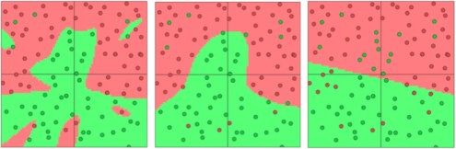
L2 regularization
The most common type of regularization is L2 regularization.
It can be implemented by augmenting the error function with the squared magnitude of all weights in the neural network. In other words, for every weight w in the neural network, we add 1/2 λw^2 to the error function.
The L2 regularization has the intuitive interpretation of heavily penalizing "peaky" weight vectors and preferring diffuse weight vectors. This has the appealing property of encouraging the network to use all of its inputs a little rather than using only some of its inputs a lot. Of particular note is that during the gradient descent update, using the L2 regularization ultimately means that every weight is decayed linearly to zero. Because of this phenomenon, L2 regularization is also commonly referred to as weight decay.
Separating green dots vs red dots, L2 regularization strengths of 0.01, 0.1, and 1

Slide 53
L1 regularization
L1 regularization is another relatively common form of regularization, where for each weight w we add the term to the objective. It is possible to combine the L1 regularization with the L2 regularization: (this is called Elastic net regularization).
The L1 regularization has the intriguing property that it leads the weight vectors to become sparse during optimization (i.e. very close to exactly zero). In other words, neurons with L1 regularization end up using only a sparse subset of their most important inputs and become nearly invariant to the “noisy” inputs.
In comparison, final weight vectors from L2 regularization are usually diffuse, small numbers. In practice, if you are not concerned with explicit feature selection, L2 regularization can be expected to give superior performance over L1.

Slide 54
Regularization
Max norm constraints. Another form of regularization is to enforce an absolute upper bound on the magnitude of the weight vector for every neuron and use projected gradient descent to enforce the constraint.
In practice, this corresponds to performing the parameter update as normal, and then enforcing the constraint by clamping the weight vector w⃗ w→ of every neuron to satisfy ∥w⃗ ∥2<c‖w→‖2<c. Typical values of cc are on orders of 3 or 4. Some people report improvements when using this form of regularization. One of its appealing properties is that network cannot “explode” even when the learning rates are set too high because the updates are always bounded.
Dropout is an extremely effective, simple and recently introduced regularization technique by Srivastava et al. in Dropout: A Simple Way to Prevent Neural Networks from Overfitting (pdf) that complements the other methods (L1, L2, maxnorm). While training, dropout is implemented by only keeping a neuron active with some probability pp (a hyperparameter), or setting it to zero otherwise.

Slide 55

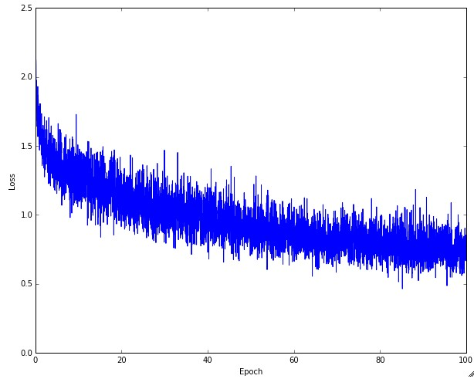
Babysitting the learning process
There are multiple useful quantities you should monitor during training of a neural network. These plots are the window into the training process and should be utilized to get intuitions about different hyperparameter settings and how they should be changed for more efficient learning.
Effects of different learning rates
An example of a typical loss function over time
The amount of “wiggle” in the loss is related to the batch size. When the batch size is 1, the wiggle will be relatively high. When the batch size is the full dataset, the wiggle will be minimal because every gradient update should be improving the loss function monotonically (unless the learning rate is set too high).

Slide 56
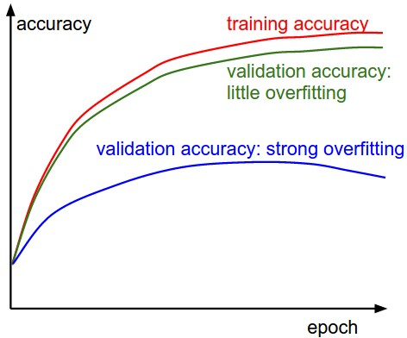
Train/Val accuracy
The second important quantity to track while training a classifier is the validation/training accuracy. This plot can give you valuable insights into the amount of overfitting in your model:
The blue validation error curve shows very small validation accuracy compared to the training accuracy, indicating strong overfitting.
When you see this in practice you probably want to increase regularization (stronger L2 weight penalty, more dropout, etc.) or collect more data.
The other possible case is when the validation accuracy tracks the training accuracy fairly well. This case indicates that your model capacity is not high enough: make the model larger by increasing the number of parameters.

Slide 57
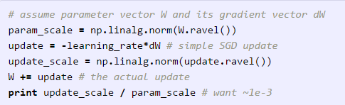
Ratio of weights:updates
The last quantity you might want to track is the ratio of the update magnitudes to the value magnitudes. Note: updates, not the raw gradients (e.g. in vanilla sgd this would be the gradient multiplied by the learning rate). You might want to evaluate and track this ratio for every set of parameters independently. A rough heuristic is that this ratio should be somewhere around 1e-3. If it is lower than this then the learning rate might be too low. If it is higher then the learning rate is likely too high. Here is a specific example:

Slide 58
Activation / Gradient distributions per layer
An incorrect initialization can slow down or even completely stall the learning process. Luckily, this issue can be diagnosed relatively easily. One way to do so is to plot activation/gradient histograms for all layers of the network. Intuitively, it is not a good sign to see any strange distributions - e.g. with tanh neurons we would like to see a distribution of neuron activations between the full range of [-1,1], instead of seeing all neurons outputting zero, or all neurons being completely saturated at either -1 or 1.

Slide 59
Artificial Neural Network
For the purpose of this derivation, we will use the following notation:
The subscript k denotes the output layer.
The subscript j denotes the hidden layer.
The subscript i denotes the input layer.
The change to a hidden to output weight depends on error (depicted as a lined pattern) at the output node and activation (depicted as a solid pattern) at the hidden node. While the change to a input to hidden weight depends on error at the hidden node (which in turn depends on error at all the output nodes) and activation at the input node.

Slide 60
Backpropagation Derivation cont…
Review of Calculus
Gradient Descent on Error
We can see the backpropagation learning algorithm as gradient descent on sum-squared error
(we square the error because we are interested in its magnitude, not its sign).
The total error in a network is given by the following equation
We want to adjust the network’s weights to reduce this overall error.

Slide 61
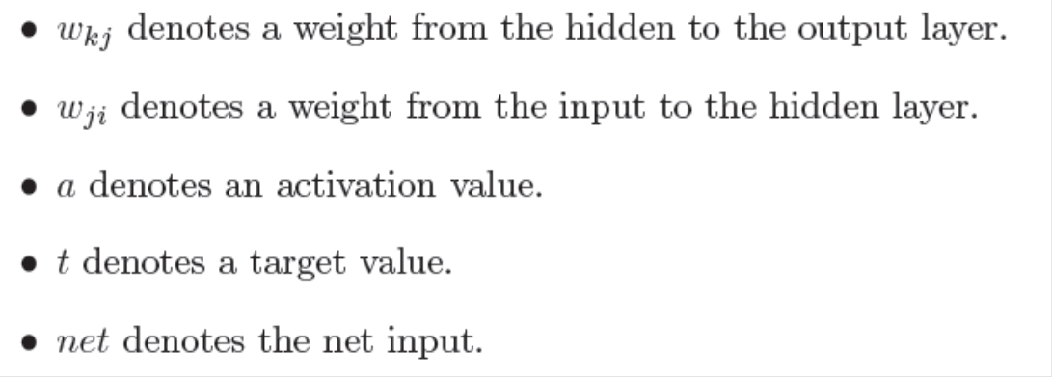
Backpropagation Derivation cont…
Lets begin at the output layer with a particular weight.
However error is not directly a function of a weight. We expand this as follows.
Let’s consider each of these partial derivatives in turn. Note that only one term of the E summation
will have a non-zero derivative: the one associated with the particular weight we are considering.

Slide 62
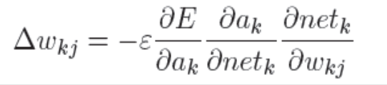
Backpropagation Derivation cont…
Derivative of the error with respect to the activation
3. Derivative of the net input with respect to a weight
Note that only one term of the net summation will have a non-zero derivative: again the one associated with the particular weight we are considering.
2. Derivative of the activation with respect to the net input
Now as
Weight change rule for a hidden to output weight
we can rewrite the result of the partial derivative as:

Slide 63
Backpropagation Derivation cont…
Now we have to determine the appropriate weight change for an input to hidden weight. This is more complicated because it depends on the error at all of the nodes this weighted connection can lead to.

Slide 64
Learning by Example
Training Algorithm: backpropagation of errors using gradient descent training.
Colors:
Red: Current weights
Orange: Updated weights
Black boxes: Inputs and outputs to a neuron
Blue: Sensitivities at each layer

Slide 65
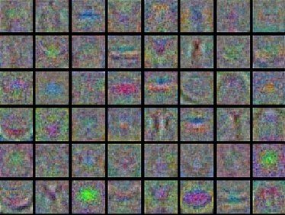
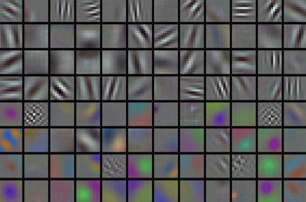
First-layer Visualizations
When one is working with image pixels it can be helpful and satisfying to plot the first-layer features visually:
Examples of visualized weights for the first layer of a neural network.
Left: Noisy features indicate could be a symptom: Unconverged network, improperly set learning rate, very low weight regularization penalty.
Right: Nice, smooth, clean and diverse features are a good indication that the training is proceeding well.

Slide 66
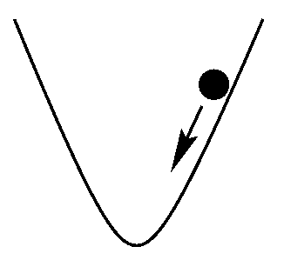
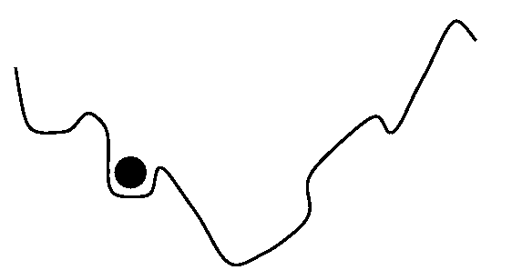
Parameter updates
Vanilla update.
The simplest form of update is to change the parameters along the negative gradient direction (since the gradient indicates the direction of increase, but we usually wish to minimize a loss function). Assuming a vector of parameters x and the gradient dx, the simplest update has the form:
x += - learning_rate * dx
where learning_rate is a hyperparameter - a fixed constant. When evaluated on the full dataset, and when the learning rate is low enough, this is guaranteed to make non-negative progress on the loss function.

Slide 67
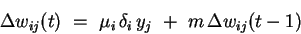
Parameter updates
Momentum Update:
With momentum m, the weight update at a given time t becomes
where 0 < m < 1 is a new global parameter which must be determined by trial and error. Momentum simply adds a fraction m of the previous weight update to the current one.
When the gradient keeps pointing in the same direction, this will increase the size of the steps taken towards the minimum.
It is therefore often necessary to reduce the global learning rate µ when using a lot of momentum (m close to 1). If you combine a high learning rate with a lot of momentum, you will rush past the minimum with huge steps!

Slide 68
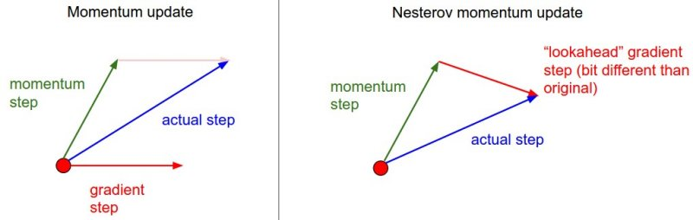
Parameter updates
Nesterov Momentum is a slightly different version of the momentum update has recently been gaining popularity. It enjoys stronger theoretical converge guarantees for convex functions and in practice it also consistenly works slightly better than standard momentum.
The core idea behind Nesterov momentum is that when the current parameter vector is at some position x, then looking at the momentum update above, we know that the momentum term alone (i.e. ignoring the second term with the gradient) is about to nudge the parameter vector by mu * v. Therefore, if we are about to compute the gradient, we can treat the future approximate position x + mu * v as a “lookahead” - this is a point in the vicinity of where we are soon going to end up. Hence, it makes sense to compute the gradient at x + mu * v instead of at the “old/stale” position x.

Slide 69
Learning Rate Adaptation
Simple heuristics can be applied to arrive at global and local learning rates. However, It is possible to refine these values significantly once training has commenced, and the network's response to the data can be observed. We will now introduce a few methods that can do so automatically by adapting the learning rates during training.
Bold Driver
A useful batch method for adapting the global learning rate µ is the bold driver algorithm. Its operation is simple: after each epoch, compare the network's loss E(t) to its previous value, E(t-1). If the error has decreased, increase µ by a small proportion (typically 1%-5%). If the error has increased by more than a tiny proportion (say, 10-10), however, undo the last weight change, and decrease µ sharply - typically by 50%.
Thus bold driver will keep growing µ slowly until it finds itself taking a step that has clearly gone too far up onto the opposite slope of the error function. Since this means that the network has arrived in a tricky area of the error surface, it makes sense to reduce the step size quite drastically at this point.

Slide 70
Learning Rate Adaptation
Annealing the learning rate
In training deep networks, it is usually helpful to anneal the learning rate over time. Good intuition to have in mind is that with a high learning rate, the system contains too much kinetic energy and the parameter vector bounces around chaotically, unable to settle down into deeper.
Knowing when to decay the learning rate can be tricky:
Decay it slowly and you’ll be wasting computation bouncing around chaotically with little improvement for a long time.
But decay it too aggressively and the system will cool too quickly, unable to reach the best position it can.

Slide 71
Learning Rate Adaptation
There are three common types of implementing the learning rate decay:
Step decay: Reduce the learning rate by some factor every few epochs. Typical values might be reducing the learning rate by a half every 5 epochs, or by 0.1 every 20 epochs. These numbers depend heavily on the type of problem and the model. One heuristic you may see in practice is to watch the validation error while training with a fixed learning rate, and reduce the learning rate by a constant (e.g. 0.5) whenever the validation error stops improving.
Exponential decay. has the mathematical form
where are hyper parameters and t is the iteration number (but you can also use units of epochs).
1/t decay has the mathematical form where are hyperparameters and t is the iteration number.
In practice, we find that the step decay dropout is slightly preferable because the hyper parameters it involves (the fraction of decay and the step timings in units of epochs) are more interpretable than the hyper parameter k.

Slide 72
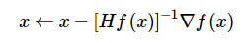
Second order methods
Newton’s method
A second, popular group of methods for optimization in context of deep learning is based on Newton’s method, which iterates the following update:
Here, is the Hessian matrix, which is a square matrix of second-order partial derivatives of the function. The term is the gradient vector, as seen in Gradient Descent. Intuitively, the Hessian describes the local curvature of the loss function, which allows us to perform a more efficient update. In particular, multiplying by the inverse Hessian leads the optimization to take more aggressive steps in directions of shallow curvature and shorter steps in directions of steep curvature. Note, crucially, the absence of any learning rate hyperparameters in the update formula, which the proponents of these methods cite this as a large advantage over first-order methods.
However, the update above is impractical for most deep learning applications because computing (and inverting) the Hessian in its explicit form is a very costly process in both space and time.

Slide 73
Per-parameter adaptive learning rate methods
All previous approaches we’ve discussed so far manipulated the learning rate globally and equally for all parameters. Tuning the learning rates is an expensive process, so much work has gone into devising methods that can adaptively tune the learning rates, and even do so per parameter. Many of these methods may still require other hyperparameter settings, but the argument is that they are well-behaved for a broader range of hyperparameter values than the raw learning rate.
Adagrad is an adaptive learning rate method
# Assume the gradient dx and parameter vector x
cache += dx**2
x += - learning_rate * dx / (np.sqrt(cache) + eps)
Notice that the variable cache has size equal to the size of the gradient, and keeps track of per-parameter sum of squared gradients. This is then used to normalize the parameter update step, element-wise. Notice that the weights that receive high gradients will have their effective learning rate reduced, while weights that receive small or infrequent updates will have their effective learning rate increased.
A downside of Adagrad is that in case of Deep Learning, the monotonic learning rate usually proves too aggressive and stops learning too early.

Slide 74
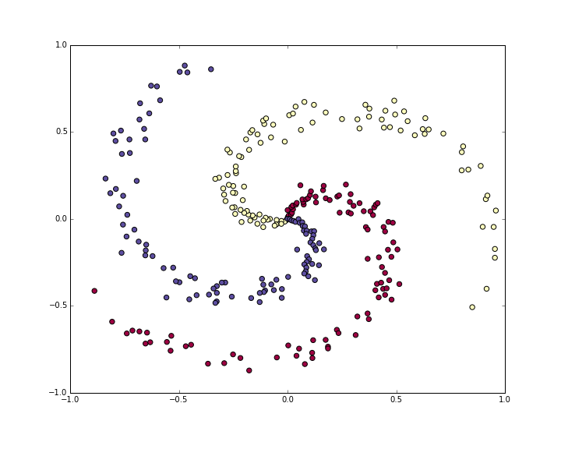
Case study
The toy spiral data consists of three classes (blue, red, yellow) that are not linearly separable.

Slide 75
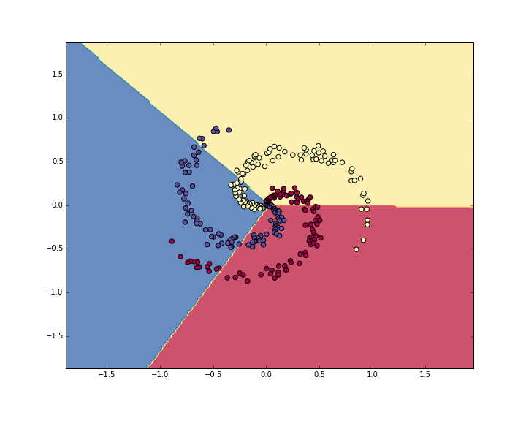
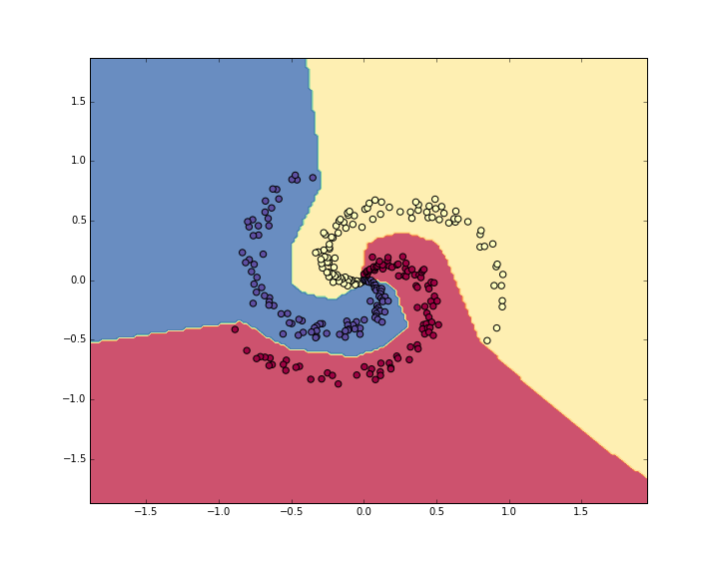
Training accuracy 49 %
Training Accuracy 98%

Slide 76
Convolutional Neural Networks (CNNs / ConvNets)
Convolutional Neural Networks are very similar to ordinary Neural Networks.
They are made up of neurons that have learnable weights and biases.
Each neuron receives some inputs, performs a dot product and optionally follows it with a non-linearity.
The whole network still expresses a single differentiable score function: from the raw image pixels on one end to class scores at the other.
And they still have a loss function (e.g. SVM/Softmax) on the last (fully-connected) layer and
All the tips/tricks we developed for learning regular Neural Networks still apply..
So what does change?
ConvNet architectures make the explicit assumption that the inputs are images, which allows us to encode certain properties into the architecture. These then make the forward function more efficient to implement and vastly reduce the amount of parameters in the network

Slide 77
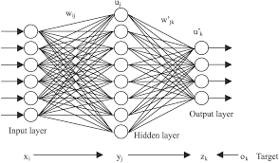
Fully Connected conventional NN
For 32 x 32 x 3 image , there would be 32*32*3 = 3072 weights / hidden Neuron.
For 200 x 200 x 3 image , there would be 200*200*3 = 120 000 weights / hidden Neuron.
Clearly, this full connectivity is wasteful and the huge number of parameters would quickly lead to overfitting.

Slide 78

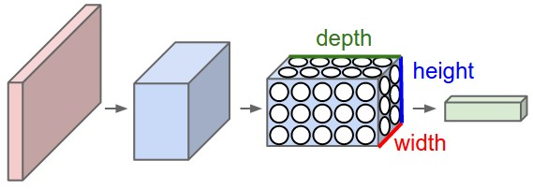
Convolutional Neural Networks
In particular, unlike a regular Neural Network, the layers of a ConvNet have neurons arranged in 3 dimensions: width, height, depth. For example, the input images in CIFAR-10 are an input volume of activations, and the volume has dimensions 32x32x3 (width, height, depth respectively).
The neurons in a layer will only be connected to a small region of the layer before it. Moreover, the final output layer would for CIFAR-10 have dimensions 1x1x10, because by the end of the ConvNet architecture we will reduce the full image into a single vector of class scores, arranged along the depth dimension
A ConvNet arranges its neurons in three dimensions (width, height, depth), as visualized in one of the layers. Every layer of a ConvNet transforms the 3D input volume to a 3D output volume of neuron activations. In this example, the red input layer holds the image, so its width and height would be the dimensions of the image, and the depth would be 3 (Red, Green, Blue channels).

Slide 79
Layers used to build ConvNets
.
A simple ConvNet is a sequence of layers, and every layer of a ConvNet transforms one volume of activations to another through a differentiable function.
We use three main types of layers to build ConvNet architectures:
Convolutional Layer,
Pooling Layer, and
Fully-Connected Layer (exactly as seen in regular Neural Networks).
These stack of layers forms a full ConvNet architecture.
Simple ConvNet for CIFAR-10 classification could have the architecture [INPUT - CONV - RELU - POOL - FC].
ReLu: The rectifier function is an activation function f(x) = Max(0, x)

Slide 80

ConvNet for CIFAR-10-VGG Net
web-based demo
Deep convolutional network for object recognition developed and trained by Oxford's renowned Visual Geometry Group (VGG), which achieved very good performance on the ImageNet dataset.

Slide 81
VGG Architecture
INPUT [32x32x3] will hold the raw pixel values of the image, in this case an image of width 32, height 32, and with three color channels R,G,B.
CONV layer will compute the output of neurons that are connected to local regions in the input, each computing a dot product between their weights and a small region they are connected to in the input volume. This may result in volume such as [32x32x12] if we decided to use 12 filters.
RELU layer will apply an elementwise activation function, such as . thresholding at zero. This leaves the size of the volume unchanged ([32x32x12]).
POOL layer will perform a downsampling operation along the spatial dimensions (width, height), resulting in volume such as [16x16x12].
FC (i.e. fully-connected) layer will compute the class scores, resulting in volume of size [1x1x10], where each of the 10 numbers correspond to a class score, such as among the 10 categories of CIFAR-10. As with ordinary Neural Networks and as the name implies, each neuron in this layer will be connected to all the numbers in the previous volume.

Slide 82
ConvNet Architecture
ConvNets transform the original image layer by layer from the original pixel values to the final class scores.
Some layers contain parameters and other don’t. In particular, the CONV/FC layers perform transformations that are a function of not only the activations in the input volume, but also of the parameters (the weights and biases of the neurons).
RELU/POOL layers will implement a fixed function.
The parameters in the CONV/FC layers will be trained with gradient descent so that the class scores that the ConvNet computes are consistent with the labels in the training set for each image.

Slide 83
ConvNet Architecture Summary
A ConvNet architecture is in the simplest case a list of Layers that transform the image volume into an output volume (e.g. holding the class scores)
There are a few distinct types of Layers (e.g. CONV/FC/RELU/POOL are by far the most popular)
Each Layer accepts an input 3D volume and transforms it to an output 3D volume through a differentiable function
Each Layer may or may not have parameters (e.g. CONV/FC do, RELU/POOL don’t)
Each Layer may or may not have additional hyperparameters (e.g. CONV/FC/POOL do, RELU doesn’t)

Slide 84
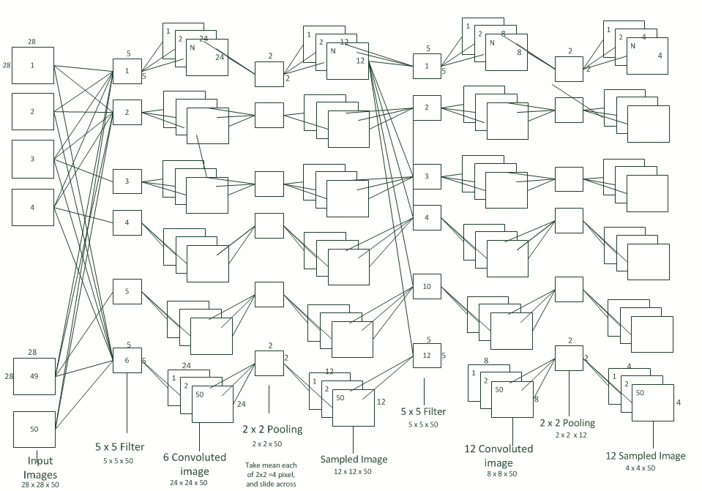
CNN Architecture

Slide 85
Compute the spatial size
We can compute the spatial size of the output volume as a function of :
The input volume size (W),
The receptive field size of the Conv Layer neurons (F)
The stride with which they are applied (S),and
The amount of zero padding used (P) on the border.
You can convince yourself that the correct formula for calculating how many neurons “fit” is given by
((W−F+2P)/S)+1.
For example for a 7x7 input (W) and a 3x3 filter (F) with stride (S)1 and pad (P) 0 we would get a 5x5 output. With stride 2 we would get a 3x3 output.

Slide 86
Spatial arrangement
Three hyperparameters control the size of the output volume: the depth, stride and zero-padding. We discuss these next:
First, the depth of the output volume is a hyperparameter: it corresponds to the number of filters we would like to use, each learning to look for something different in the input.
Second, we must specify the stride with which we slide the filter. When the stride is 1 then we move the filters one pixel at a time. When the stride is 2 then the filters jump 2 pixels at a time as we slide them around. This will produce smaller output volumes spatially.
Sometimes it will be convenient to pad the input volume with zeros around the border.
The size of this zero-padding is a hyperparameter. The nice feature of zero padding is that it will allow us to control the spatial size of the output volumes (most commonly as we’ll see soon we will use it to exactly preserve the spatial size of the input volume so the input and output width and height are the same).

Slide 87
Real-world example
The Krizhevsky et al. architecture that won the ImageNet challenge in 2012 accepted images of size [227x227x3].
On the first Convolutional Layer, it used neurons with receptive field size F=11, stride S=4 and no zero padding P=0.
Since (227 - 11)/4 + 1 = 55, and since the Conv layer had a depth of K=96 (No of filters), the Conv layer output volume had size [55x55x96].
Each of the 55*55*96 neurons in this volume was connected to a region of size [11x11x3] in the input volume.
Moreover, all 96 neurons in each depth column are connected to the same [11x11x3] region of the input, but of course with different weights. As a fun aside, if you read the actual paper it claims that the input images were 224x224, which is surely incorrect because (224 - 11)/4 + 1 is quite clearly not an integer. This has confused many people in the history of ConvNets and little is known about what happened. My own best guess is that Alex used zero-padding of 3 extra pixels that he does not mention in the paper.

Slide 88
Parameter Sharing
Parameter sharing scheme is used in Convolutional Layers to control the number of parameters.
Using the real-world example above, we see that there are 55*55*96 = 290,400 neurons in the first Conv Layer, and each has 11*11*3 = 363 weights and 1 bias.
Together, this adds up to 290400 * 364 = 105,705,600 parameters on the first layer of the ConvNet alone. Clearly, this number is very high.
That if one feature is useful to compute at some spatial position (x,y), then it should also be useful to compute at a different position (x2,y2). In other words, denoting a single 2-dimensional slice of depth as a depth slice (e.g. a volume of size [55x55x96] has 96 depth slices, each of size [55x55]).

Slide 89
Parameter Sharing
With this parameter sharing scheme, the first Conv Layer in our example would now have only 96 unique set of weights (one for each depth slice), for a total of 96*11*11*3 = 34,848 unique weights, or 34,944 parameters (+96 biases). Alternatively, all 55*55 neurons in each depth slice will now be using the same parameters. In practice during backpropagation, every neuron in the volume will compute the gradient for its weights, but these gradients will be added up across each depth slice and only update a single set of weights per slice.
Notice that if all neurons in a single depth slice are using the same weight vector, then the forward pass of the CONV layer can in each depth slice be computed as a convolution of the neuron’s weights with the input volume (Hence the name: Convolutional Layer). This is why it is common to refer to the sets of weights as a filter (or a kernel), that is convolved with the input.

Slide 90
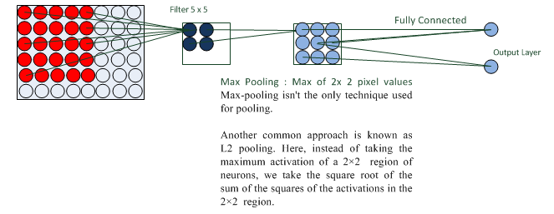
CNN Architecture

Slide 91
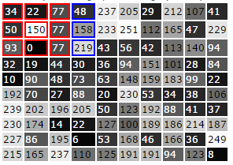
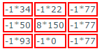
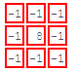



Convolution filter
An example small grayscale image (10x10)
To apply the convolution filter multiply the filter values with the image data block. Work with each pixel and its 3x3 neighborhood:
Then sum all the values: (-34)+(-22)+(-77)+ (-50)+(1200)+(-77)+ (-93)+(0)+(-77) = 770
Divide by the divisor. (770/divisor)+bias=770 (in this example divisor=1)
If the new pixel value is > 255 set it to 255 If the new pixel value is < 0 set it to 0
An example convolution filter for line detection
Continue with all other 3x3 blocks in the image using original values. For example the next image block could be
The row=2, column=2 pixel and its neighborhood from the image above: The row=2, column=2 pixel and its neighborhood from the image above:
Most of the image is processed in this manner. Image borders create problems and are ignored.

Slide 92









Convolution Filter
Blur
Edge Detect
Edge Enhance
Emboss
Sharpen

